Slide 1

Fish Species Selection and Growth Monitoring for Sustainable Aquaculture
Group Members
Sajid Ali(21p-8023)
Muhammad Nauman (21P-8045)
Ammar Raza (21P-8004)
Project Supervisor
Sir Usman Wajid

Slide 2
Introduction
Aquaculture is the farming of fish, crustaceans, and aquatic plants in controlled environments to meet global seafood demand. It supports food security and reduces pressure on wild fish stocks.
Aquaculture provides us with:
Importance of water quality
Species Recommendation
Growth Optimization
Sustainability
Efficient Resource Use
Disease Detection

Slide 3
Problem Statement
Aquaculture faces challenges such as suboptimal fish growth due to traditional methods, difficulties in choosing the right fish species, and resource wastage from poor water management. Inadequate disease detection tools increase the risk of outbreaks, which impacts fish health and overall productivity.

Slide 4
Objectives
The objective of this project is to develop an advanced aquaculture system that includes a fish type classification model, size and growth monitoring, behavior tracking, and disease detection to improve fish farming practices.
The project aims to integrate these modules with sensors and existing systems to create a reliable solution that ensures fish health and productivity. Real-time alerts and a user-friendly web/app interface will be developed to help users monitor fish conditions, receive notifications, and take timely actions.

Slide 5
Literature Review
Sr. no | Year | Basic Idea | Methodologies | Results | Limitations
[1]. | 2024 | IoT-based Smart Pond Water Quality Monitoring | IoT-enabled system collecting water data (e.g., pH, temperature, turbidity) using a mobile robot | Improved real-time monitoring and informed decisions for water quality management | Requires continuous data validation to avoid false readings and potential disruptions from harsh environmental conditions​
[2] | 2024 |  | IoT and ML-based system for water quality monitoring and fish species recommendation | Enhanced productivity with 94% accuracy in fish species recommendation | Limited scalability for larger fish farms, susceptibility to interference from biological factors
[3] | 2023 | Advanced IoT-AI System for Fish Health Monitoring | Integrated sensors and cloud computing for real-time health tracking |  | Risk of data gaps due to intermittent connectivity, and challenges in adapting algorithms to new environmental data​
[4] | 2022 |  | Neural networks and YOLO object detection for video analysis of fish behavior |  | Sensitivity to changes in water clarity and behavior interpretation can be challenging due to overlapping fish movements​
Fish Farming and Water Quality Integration
Enhanced disease prevention and effective remote monitoring
Deep Learning for Fish Behavior Analysis
Accurate prediction of fish behavior under various conditions, aiding farm management

Slide 6
Sr. no | Year | Basic Idea | Methodologies | Results | Limitations
[5] | 2019 | Machine Vision for Fish Length Estimation . | R-CNNs used to estimate fish length from images | High accuracy in fish length measurement | Prone to inaccuracies in dynamic or highly reflective water surfaces, and calibration issues when switching between environments​
[6] | 2019 | Water Quality Standards for Fish Health | ML to assess water quality | Enabled data-driven decisions for improved fish growth and reduced disease incidence | Requires consistent maintenance to ensure sensor accuracy, and data reliability can be impacted by sudden environmental changes​
[7] | 2015 | Computer Vision for Fish Sizing | Stereo camera system for non-invasive fish size monitoring | Effective and non-intrusive fish size tracking | Reduced reliability in high-activity tanks and difficulty in distinguishing fish from similarly colored backgrounds​

Slide 7
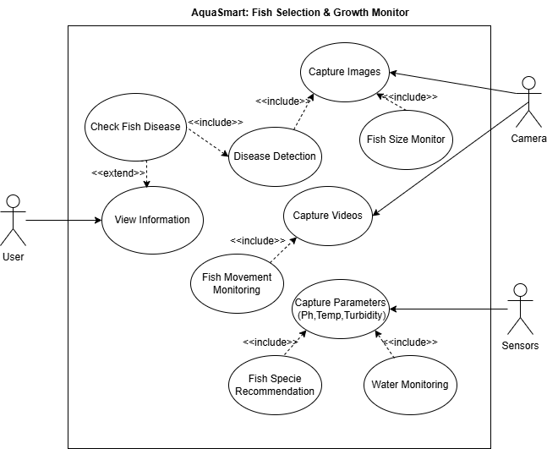
UML Diagram
Use Case Diagram
Fig 1.0: Use Case Diagram

Slide 8
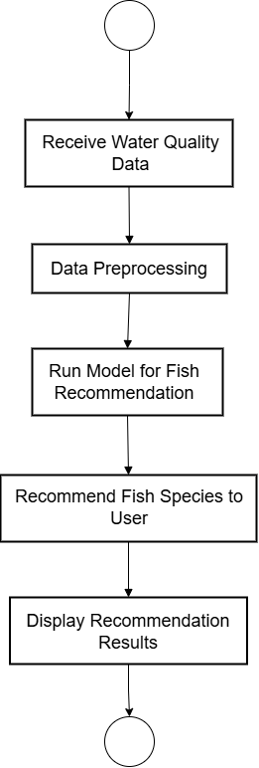
UML Diagram
Fish Recommendation
Fig 2.1: Activity Diagram

Slide 9
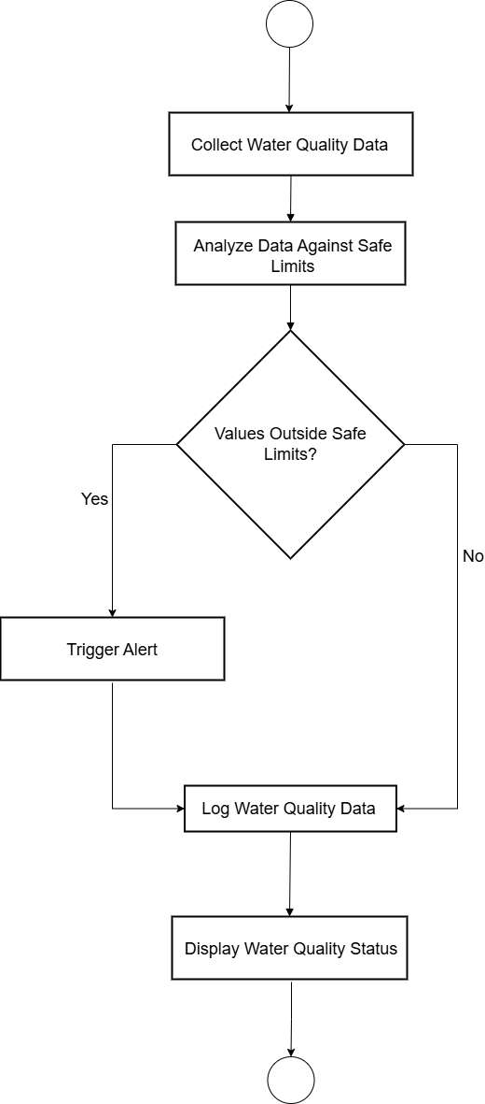
UML Diagram
Water Quality Monitoring
Fig 2.2: Activity Diagram

Slide 10
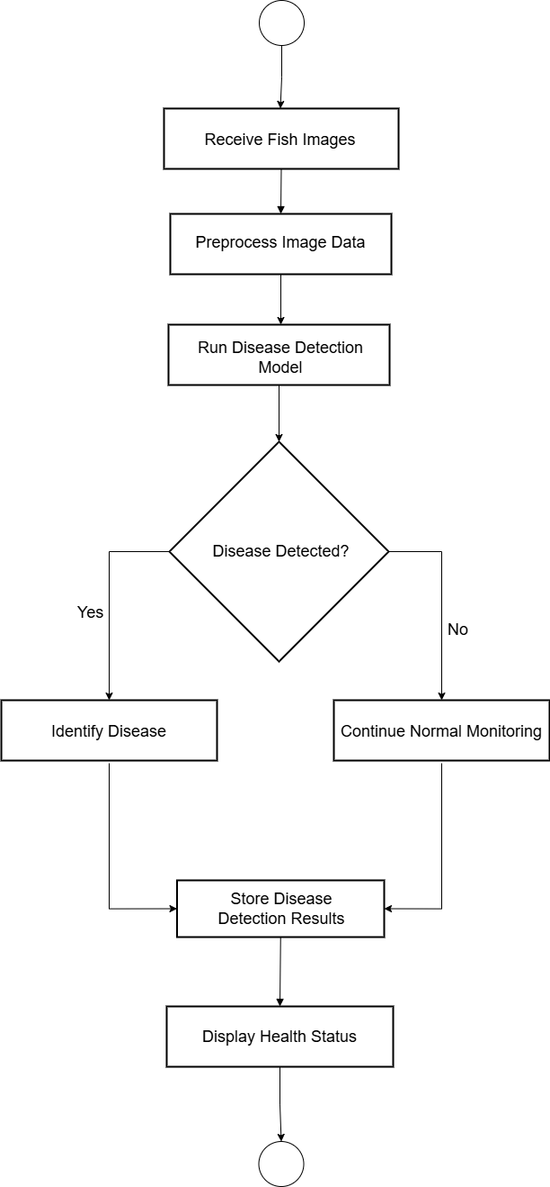
UML Diagram
Disease Detection
Fig 2.3: Activity Diagram

Slide 11
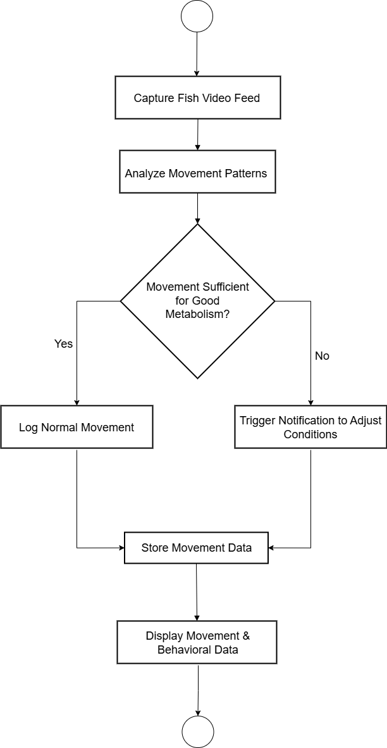
UML Diagram
Movement Monitoring
Fig 2.4: Activity Diagram

Slide 12
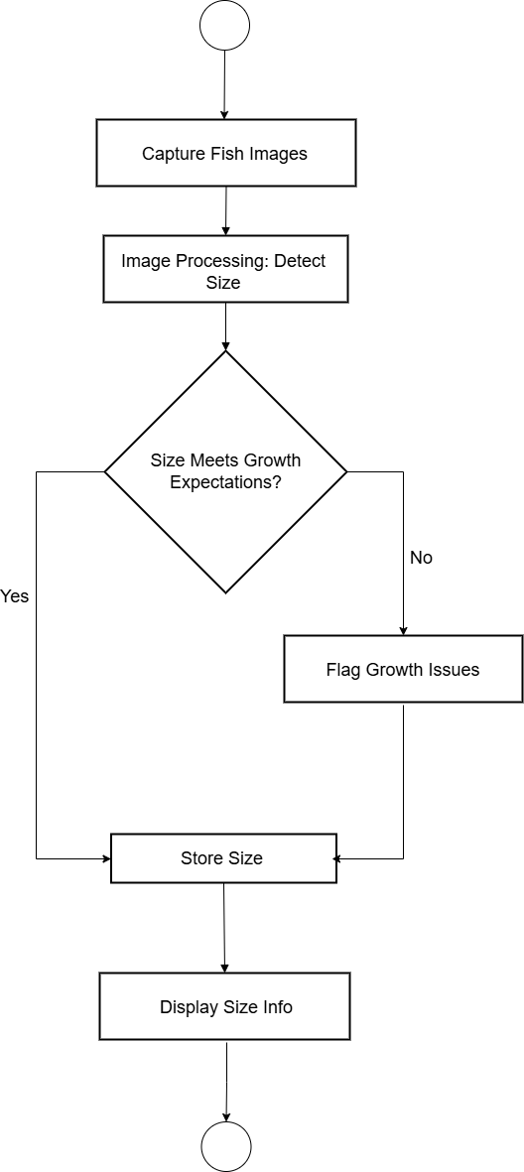
UML Diagram
Size Monitoring
Fig 2.5: Activity Diagram

Slide 13
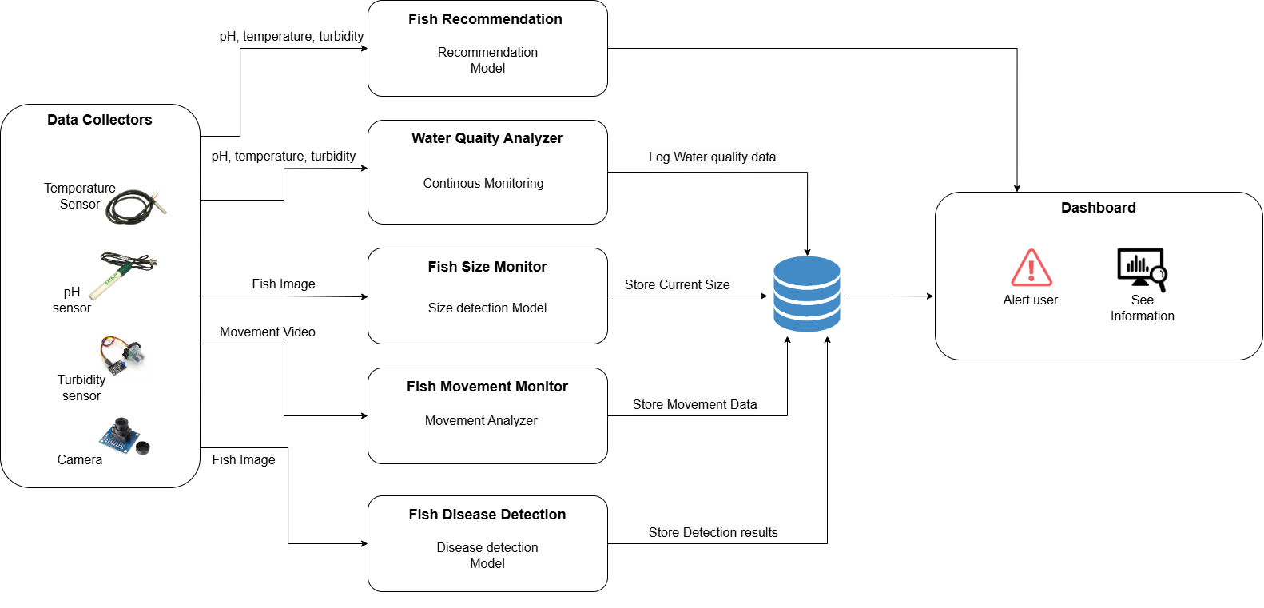
ARCHITECTURE Diagram
Fig 3: Architecture Diagram

Slide 14
Team Work
Sajid Ali
FYP 1: FYP 2:
Research fish species classification and develop AI/ML model for species selection. Implement continuous monitoring with real-time alerts for parameter fluctuations.
Gather system requirements for continuous monitoring of water parameters. Validate and optimize the classification model using real-time sensor data.
Muhammad Nauman
FYP 1: FYP 2:
Develop algorithms for continuous monitoring of water parameters, focusing on data analysis. Implement disease detection module using computer vision for image analysis.
Create user alerts based on sensor readings for necessary interventions. Create a notification system for detected diseases and treatment recommendations
Ammar Raza
FYP 1: FYP 2:
Design size monitoring module with camera integration for weekly assessments. Refine size monitoring algorithms for accurate assessments.
Set up backend structure and conduct initial system integration testing. Finalize user interface to integrate all modules (monitoring, size, movement, disease detection).

Slide 15
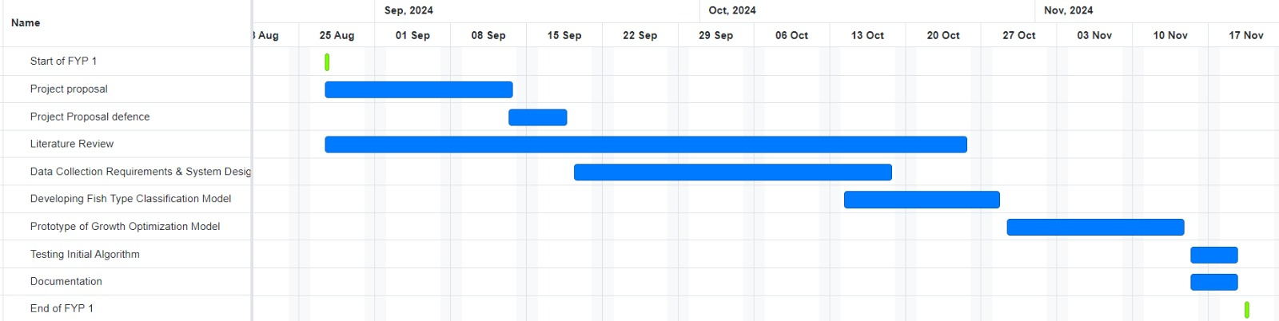
FYP 1 Gantt Chart
Fig 4: FYP-1 Gantt Chart

Slide 16
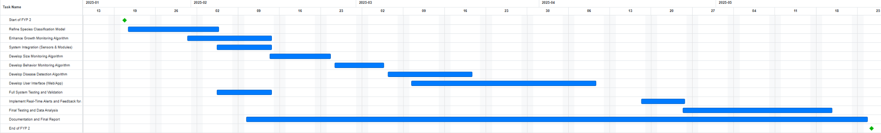
FYP 2 Gantt Chart
Fig 4: FYP-2 Gantt Chart

Slide 17
References
M. M. Hemal, A. Rahman, Nurjahan, F. Islam, S. Ahmed, M. S. Kaiser, and M. R. Ahmed, "An Integrated Smart Pond Water Quality Monitoring and Fish Farming Recommendation Aquabot System," Sensors, vol. 24, no. 3682, pp. 1-22, Jun. 2024.
K. S. B. Keerthi and R. Subhashini, "Tracking of Fish Behaviour Using Computer Vision and Deep Learning," Mathematical Statistician and Engineering Applications, vol. 71, no. 3s2, pp. 1635-1644, Jul. 2022​
G. G. Monkman, K. Hyder, M. J. Kaiser, and F. P. Vidal, "Using machine vision to estimate fish length from images using regional convolutional neural networks," Methods in Ecology and Evolution, vol. 10, pp. 2045-2056, 2019​
A. F. Abdullah, H. Che Man, A. Mohammed, M. M. A. Karim, S. U. Yunusa, and N. A. B. M. Jais, "Charting the aquaculture internet of things impact: Key applications, challenges, and future trend," Aquaculture Reports, vol. 39, 2024
M. Ahmed, M. O. Rahaman, M. Rahman, and M. A. Kashem, "Analyzing the Quality of Water and Predicting the Suitability for Fish Farming based on IoT in the Context of Bangladesh," presented at the 2019 International Conference on Sustainable Technologies for Industry 4.0 (STI), Dhaka, Bangladesh, Dec. 2019​
A. Rodriguez, A. J. Rico-Diaz, J. R. Rabunal, J. Puertas, and L. Pena, "Fish Monitoring and Sizing Using Computer Vision," in Lecture Notes in Computer Science, vol. 9108, J. M. Ferrández Vicente et al., Eds. Cham: Springer, 2015, pp. 419-428
A. Waleed, H. Medhat, M. Esmail, K. Osama, R. Samy, and T. M. Ghanim, "Automatic Recognition of Fish Diseases in Fish Farms," Faculty of Computer Science, Misr International University, Cairo, Egypt​
R. Law, "Fishing, selection, and phenotypic evolution," ICES Journal of Marine Science, vol. 57, pp. 659–668, 2000

